Slide 1
What is Philosophy?
OC introduction

Slide 2
What is Philosophy?
Everyone knows what philosophy is to them…even if you’ve never studied it
First job – write down a single sentence definiton that sums up philosophy
Then write it on the board
What do they share?
Where do they differ?

Slide 3
Definitions..
When we look at these definitions it becomes very clear that certain things are associated by most of us with philosophy…
…but that also we see it via highly individualised points of view, perspectives
What we have here is a collection that needs a little extra depth to help explain why philosophy is different from human science or natural science or art, how it is unique…
How can identify the connecting thread that binds them all together?
Task One – A3 sheet – Discoveries and questions
Read through and research the discoveries if you need to
Then complete the qs at the bottom a b c d – what is your group’s answer to q d?

Slide 4
What is the nature of philosophy’
Having identified the thread that binds all our definitions together, we now need to further define what this means….
If philosophy is just dealing with questions to whoch we have no answer, how do we ever gauge or measure progress in the field?
Why are we still dealing with questions that were being asked back in Classical Greece by Plato and Aristotle for example?
Task Two – A4 sheet – Classical Greece vs 21st century Switzerland
Read through the sheet and highlight at the top the qs that Greeks couldn’t answer
Then at the bottom, repeat the activity but whilst thinking about your world now..
What becomes obvious once this has been completed?

Slide 5
Progress in philosophy
Given our conclusions about Classical Greece and 21stC Swutzerland the, it becomes clear that philosophy has progressed over the ages
The advance of knowledge in natural science and human sciences have answered a lot of previously unanswerable questions
Progress is evident in the types of questions that are left
The questions that are left therefore can be seen as more ‘niche’, more specialized….more interesting!?
What types of questions ahve therefore been left?

Slide 6
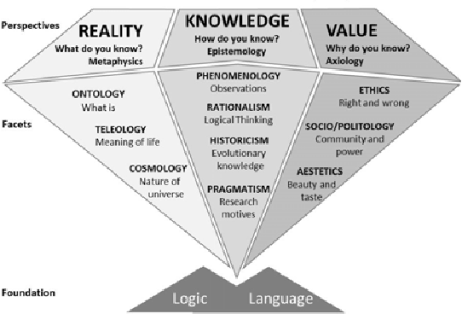

Slide 7
Philosophy at the heart of our world
So how do we ‘do’ philosophy?
Start with any basic statement about your world…for example, we all got to school today, but did any of you conduct a philosophical examination of this? (this happens on a regular basis with toddlers btw - just for future reference ☺)
How did I get to school today? By car;
How did that happen? I got in the car and off it went;
Why did it go? The car started and continued on its journey;
Why did the car start? Ignition of the fuel by spark plugs;
Why does that work? Fuel ignites at a certain temperature;
Why does fuel ignite at a certain temperature? It’s a law of physics;
Why is that a law of physics? It is how the universe works;
Why does the universe work like that? It’s the way it was made;
Why was the universe made like this? ☺

Slide 8
Why?
Indeed…why?
Why bother with all these questions, examinations, in depth enquiry?
Why not just take things at face value and live in blissful ignorance?
Because ignorance is never really that blissful…
..at some stage, you will need to understand why in order to be….
‘The unexamined life is not worth living’
– Socrates, Apology 38a (Plato 399 BCE)

Slide 9
