Slide 1
Matu catch-up
- French revolution

Slide 14
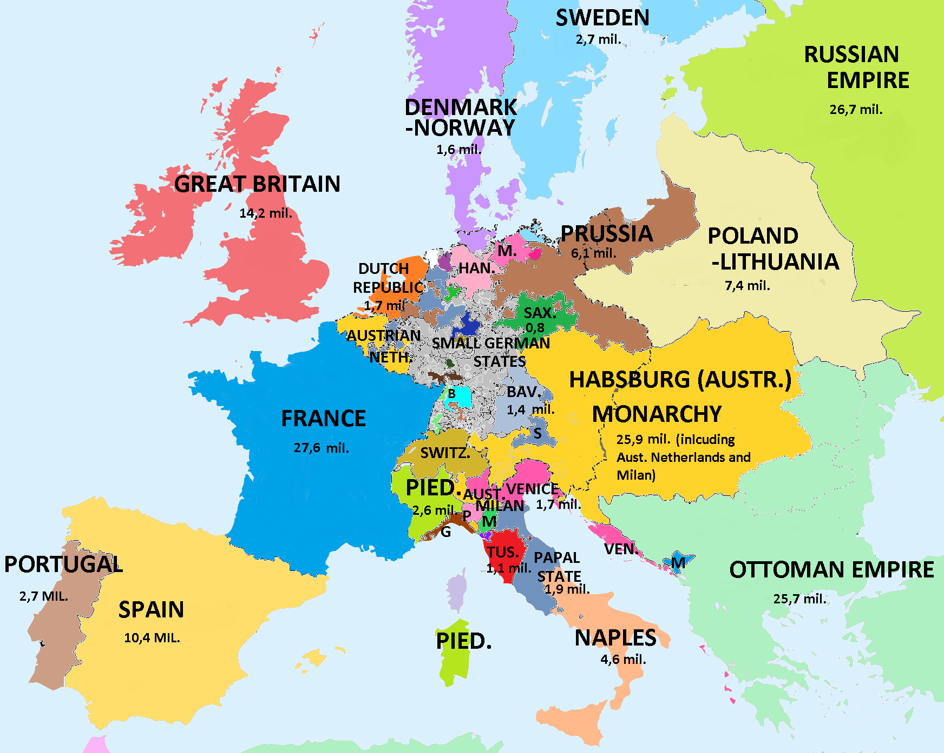
Europe + populations 1789

Slide 15
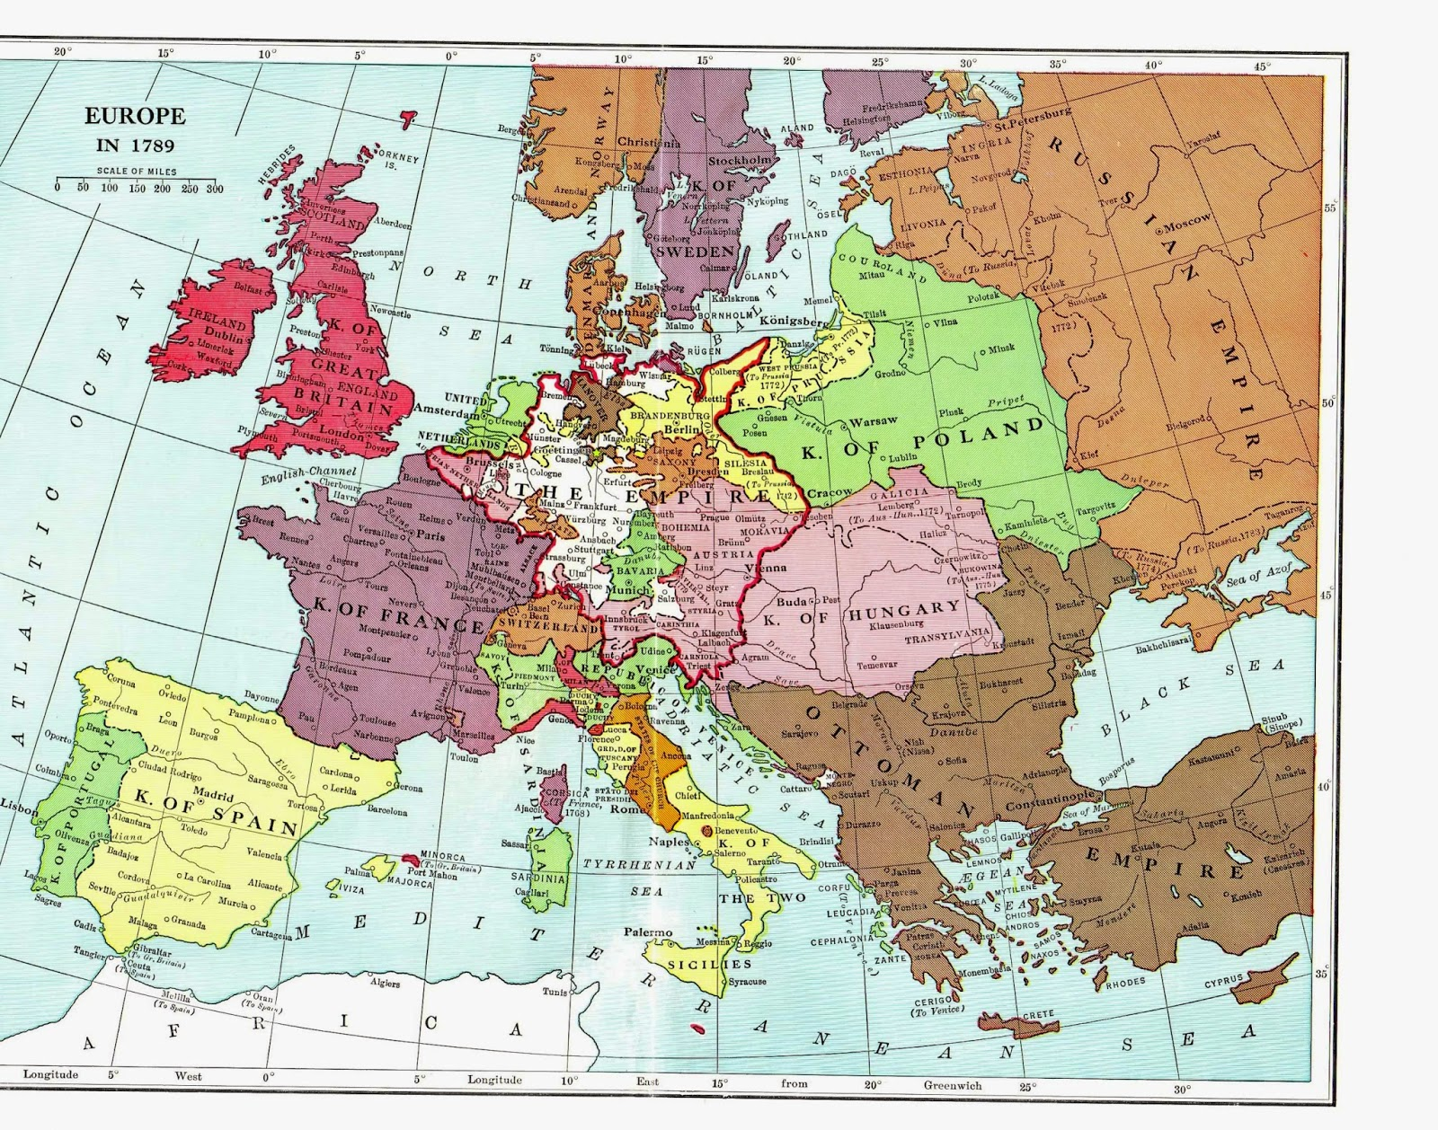

Slide 16
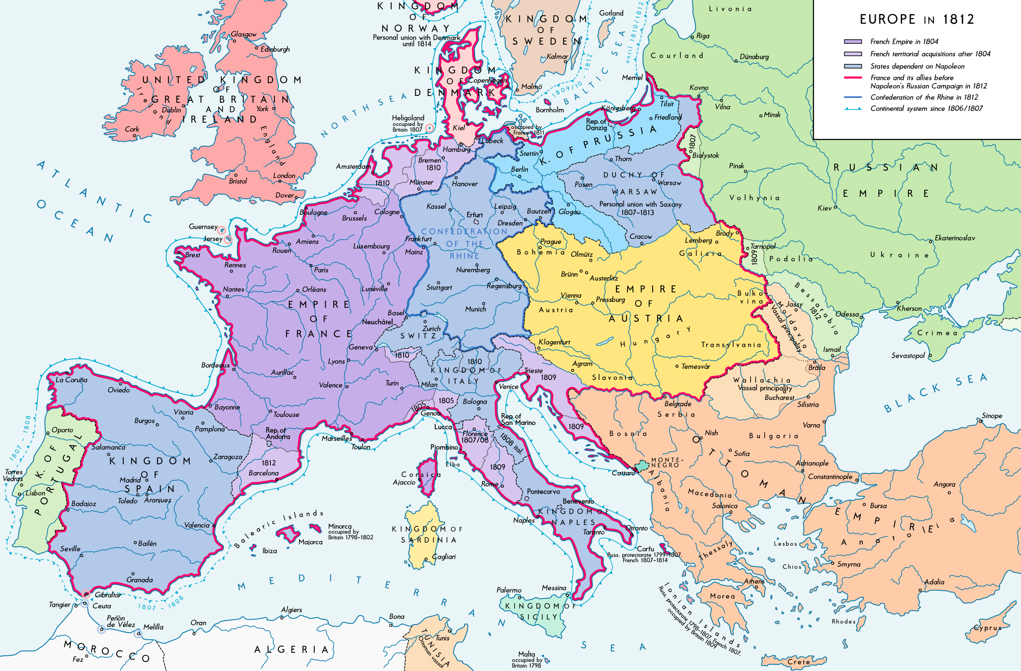

Slide 17
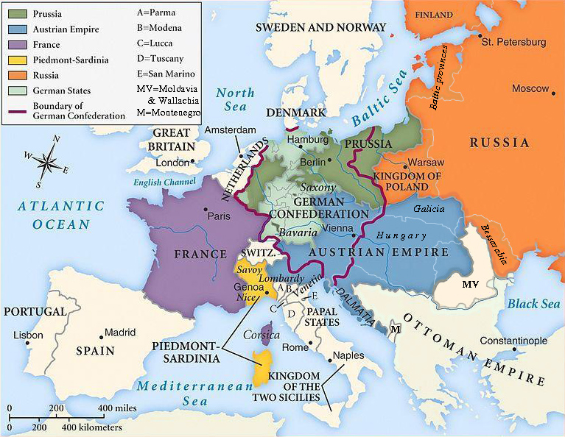
Europe in 1815 after the Congress of Vienna

