Slide 1
The Age of Explorations
When people in Europe began to explore the rest of the world

Slide 2
What we will learn
Why people didn’t explore
Why people began to explore
Have used your thinking and writing skills

Slide 3
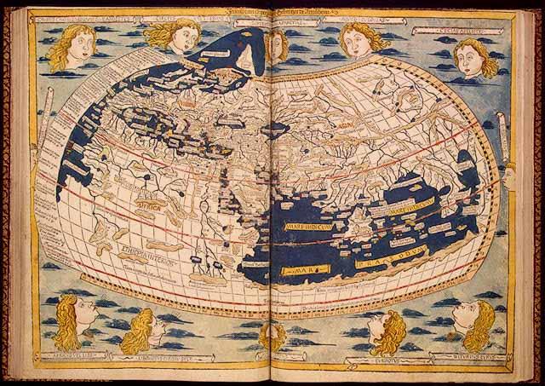
Map of world before explorations
The above map is the map of what people thought the world looked like before the 1400’s.

Slide 4
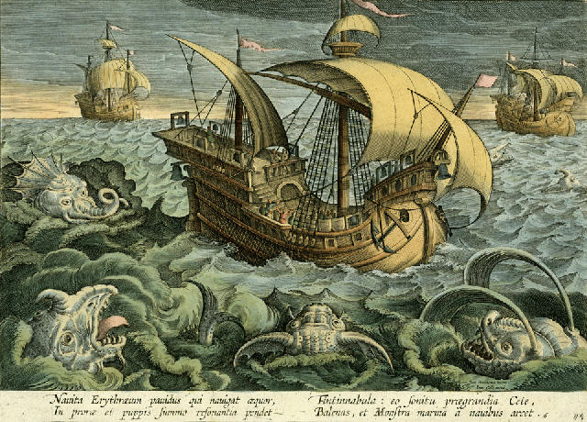
WHY did people not know what the world actually looked like?
People had no idea what the world actually looked like because there was a fear of the unknown.
People believed that
There were sea monsters
The further south you travelled you would boil
The world was flat and you would fall off the edge

Slide 5
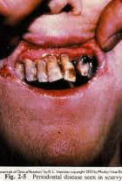
Another reason why
At this time if people went on long sea journeys there was no way of keeping food fresh.
Without continued fresh food many sailors would develop an illness called scurvy.
Scurvy is caused by a lack of vitamin C

Slide 6
Why explore?
There were three main reasons why Europeans wanted to explore
TRADE
RELIGION
EMPIRE BUILDING
Notes:
Ask students first

Slide 7
trade
Europeans had, up to this point in history, had trade links with India,
China and the Spice Islands
Spices and silks were very valuable commodities in Medieval Europe
  Used in cooking, medicines and dye for clothes
Getting these goods would take months and years
Then the trade routes became dangerous with the growth of the
Turkish Empire
The Muslim Turks were enemies of the European Christians
The European population also began to rise and therefore there
was a greater demand on these goods

Slide 8
2. religion
At this time most Europeans were Christian
Europeans believed it was there duty to spread the
message of the Christian god
As a result most of the ships that went on these journeys
brought with them priests and the aim was to convert where
they conquered

Slide 9
3. Empire building
Many European countries wanted to build empires
They wanted to control new lands and exploit their natural resources
Europeans thought that they were superior (better) than the people of the countries they conquered

Slide 10
Time to think 1
Mention THREE reasons why people were afraid to explore the world of the open ocean?
Give TWO reasons why rulers were prepared to sponsor voyages during the Age of Exploration?
Give TWO reasons why spices were so important in the fifteenth and sixteenth centuries?

Slide 11
What helped them explore?
New ship called a caravel
New navigational instruments

Slide 12
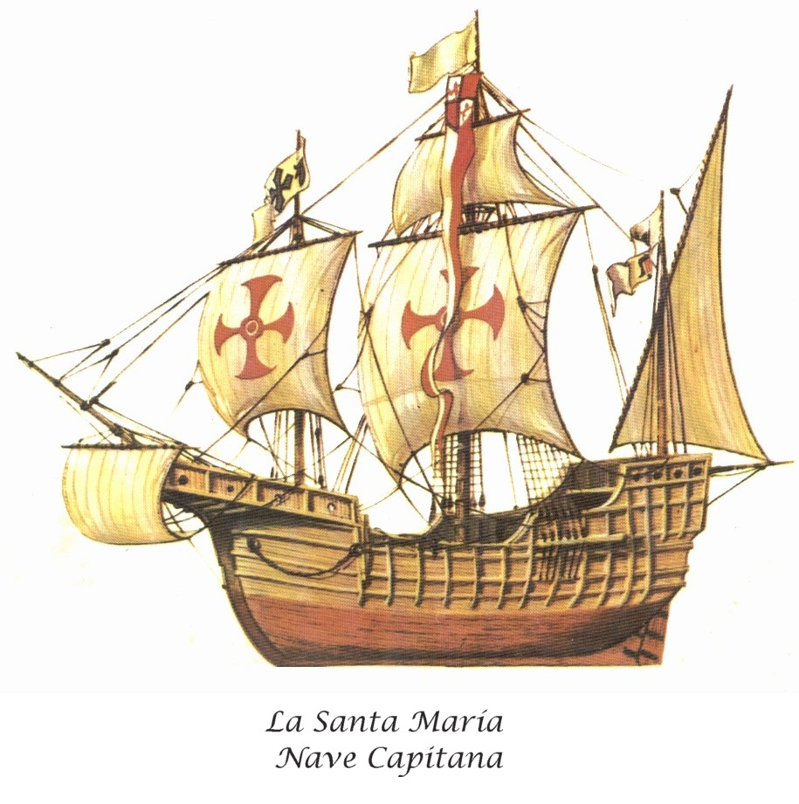
The caravel
The new ship was better able for the rough Atlantic Ocean
The ships were clinker built (over lapping timbers to withstand the strong Atlantic waves)
The ships also had lateen sails which made them easier to navigate

Slide 13
2. New instruments
The compass
The astrolabe
The quadrant
Portolan charts

Slide 14
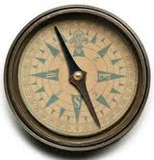
I. the compass
The compass allowed sailors to know which direction they were traveling in. The magnet will always point north if you’re north of the equator

Slide 15
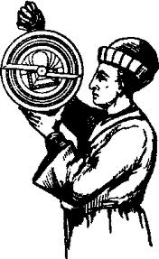
Ii. the astrolabe
The astrolabe measured the latitude by studying the sun during daylight hours

Slide 16
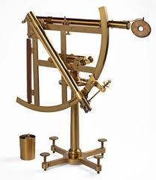
Iii. the quadrant
The quadrant was used to measure the latitude by studying the position of the stars in the night sky

Slide 17
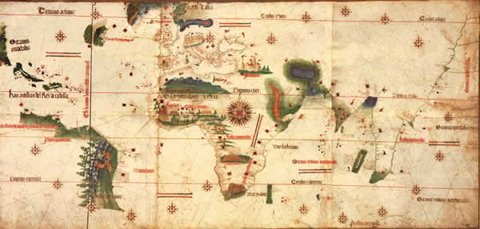
iv. Portolan charts
Portolan charts were maps of the sea. They recorded the shape of the coast line, winds and depth of water.
Log, line and knots was how sailors measured the speed of the ship.

Slide 18
Time to think 2
Describe how each of the following developments in navigation made longer sea voyages possible during the fifteenth and sixteenth centuries
  Portolan chart:
  Astrolabe:
  Log and line:
  Compass:
  Quadrant:

Slide 19
The search for the bottom of Africa
Prince Henry the Navigator

Slide 20
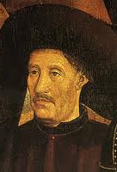
Prince henry of Portugal
Prince Henry the navigator was interested in finding a new trade route to India. He was convinced that if he did that Portugal would become a very wealthy country from the trade.
He set up a school for sailors and invited the best sailors, mapmakers and instrument makers to some together at the port of Sagres and share ideas. It was here that many of the new instruments were developed and improved upon.

Slide 21
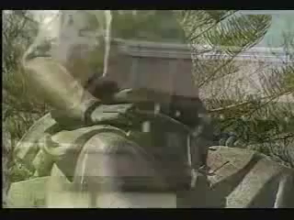
Prince Henry

Slide 22
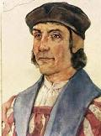
Diaz does it!
Bartolomeu Diaz was the first known sailor to reach the bottom of Africa.
His ship suffered severe storms but he managed to survive and sail home. Later the bottom of Africa become known as the Cape of Good Hope.
With the bottom of Africa discovered it was only a matter of time before the sea route to India would be discovered.

Slide 23
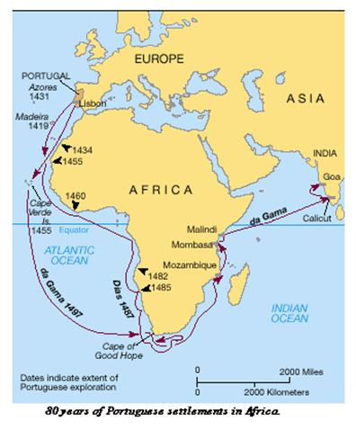
Vasco da Gama
Vasco da Gama was the man who led the first known journey around the Cape of Good Hope and on to India. With this new trade route established Portugal would now become a very rich and powerful country in Europe.

Slide 24
Time to think 3
Name the European country that discovered the sea route to India around the year 1,500
What type of school did Prince Henry of Portugal set up in 1420?
Who was the first person to successfully sail the whole length of the west cost of Africa?
Who was the first person to successfully sail around the south of Africa and to India?

Slide 25
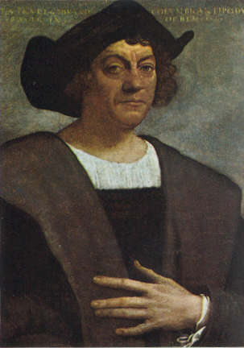
Christopher Columbus
His exploration that led to the discovery of America

Slide 26
Columbus
Born in Genoa Italy
Served in Portuguese navy
Believed that the world was a sphere
Was sponsored by Spain
Set sail in 1492

Slide 27
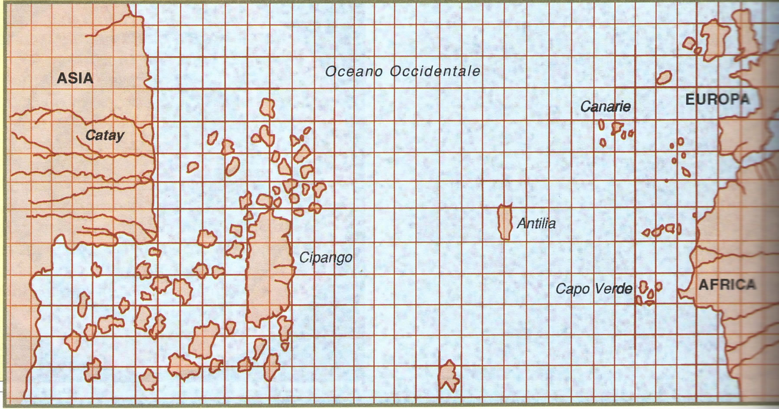
What Columbus thought
CATAY = CHINA
CIPANGO = JAPAN

Slide 28
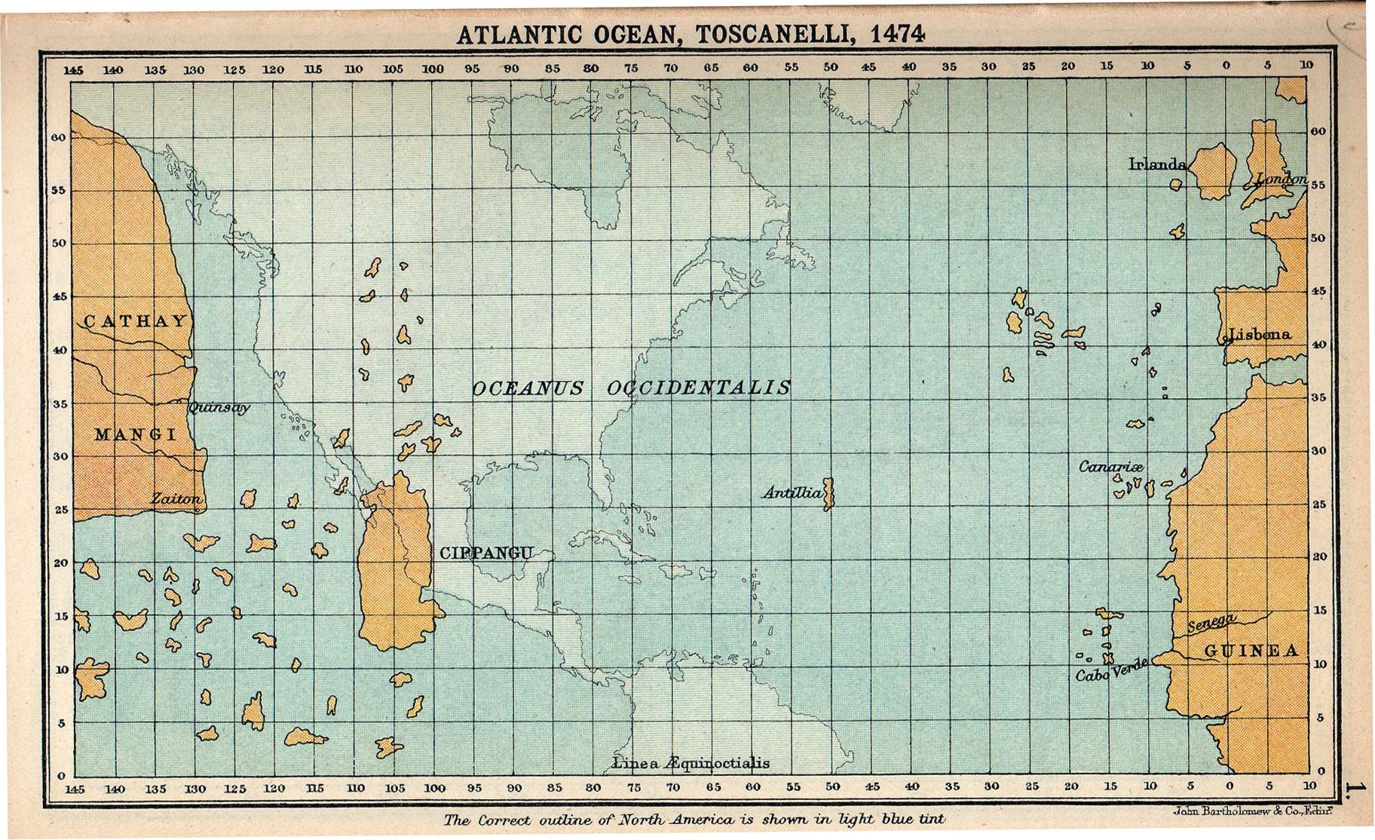
The same map with u.s.a.

Slide 29
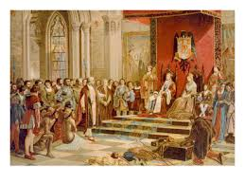
Sponsorship
Journeys of great exploration were very expensive and the people with money were the monarchs of Europe
Columbus sought sponsorship from Portugal to fund his journey
Portugal refused as they were happy with the African route
Columbus went to Spain where the King & Queen, Ferdinand and Isabella, agreed to sponsor him
Notes:
What is sponsorship? Why?

Slide 30
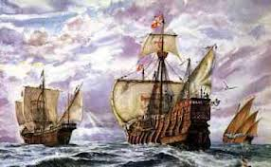
Voyage one
Columbus had three ships
The Nina, Pinta and the Santa Maria
The set sail in 1492
Stopped in the Canary Islands
Columbus thought the entire journey would take three weeks
Sailors began to get scurvy
Columbus kept two logs
One log was the true distance the other a false account so that the sailors wouldn’t panic
After over two months land was discovered (San Salvador).

Slide 31
Time to think 4
What did Columbus believe about the journey West?
What does sponsorship mean?
What country would NOT sponsor him first?
What country sponsored the journey in the end?
Name THREE of his ships
What was a log book?
What land mass had Columbus’s expedition landed on?

Slide 32
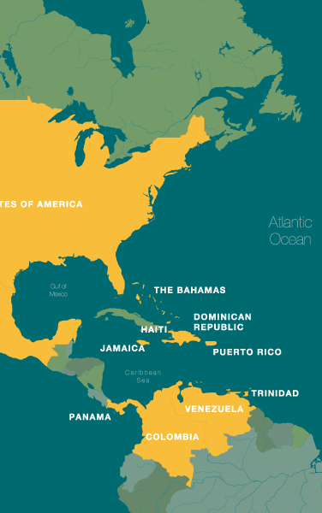
Where had Columbus landed?
Columbus was convinced that he had finally landed in Asia.
He had in fact landed in what is known today as the Caribbean Islands

Slide 33
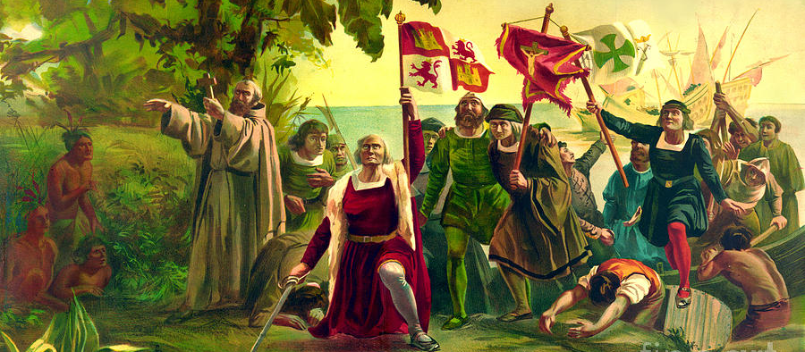
The landing
What do you notice about the picture?
Notes:
How are they dressed? Would you say this is realistic? Why draw like this?

Slide 34
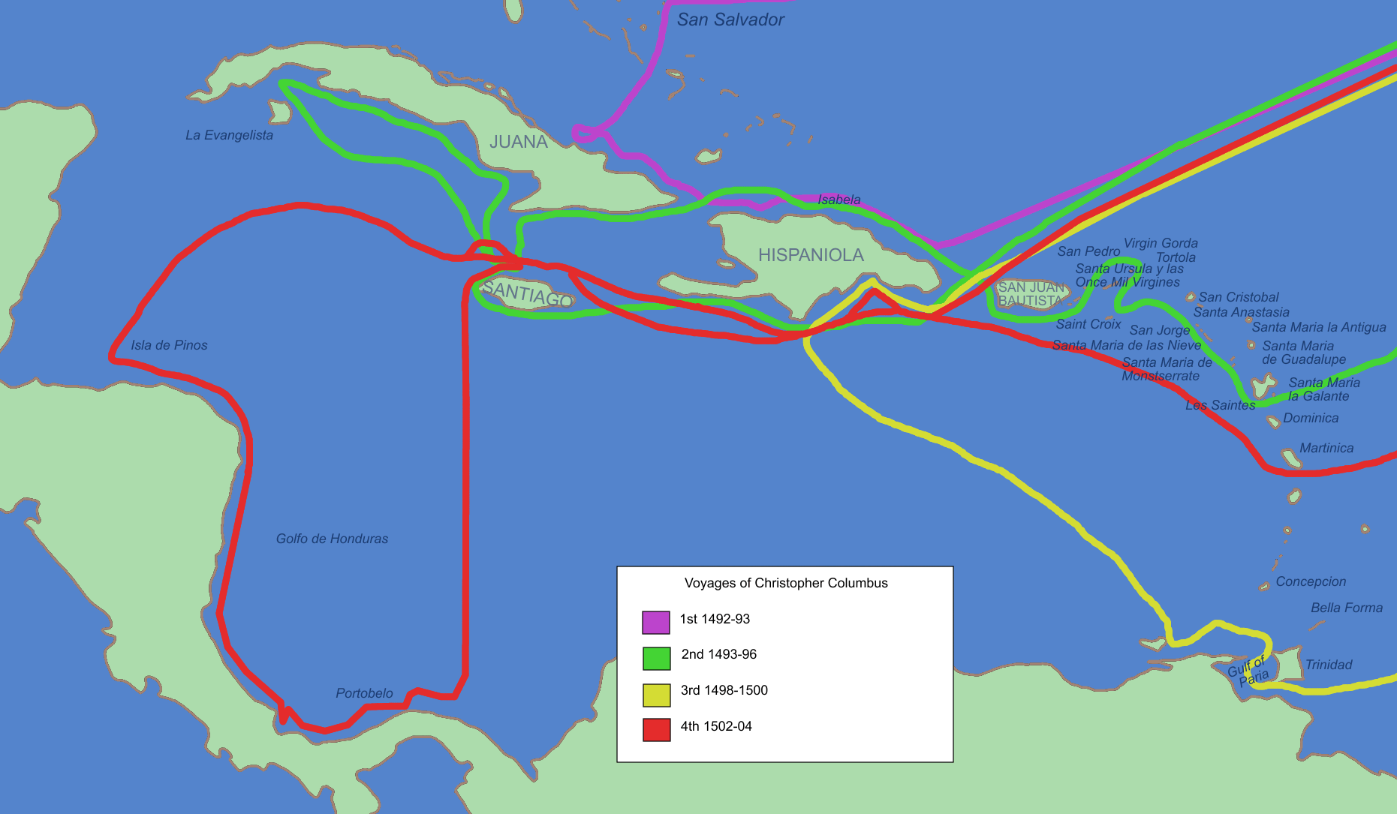
On the islands
Columbus spent the three months exploring the islands of the Caribbean.
He placed the Spanish flag and Christian cross on the island
He called the locals Indians
Discovered the islands of Cuba and Hispaniola

Slide 35
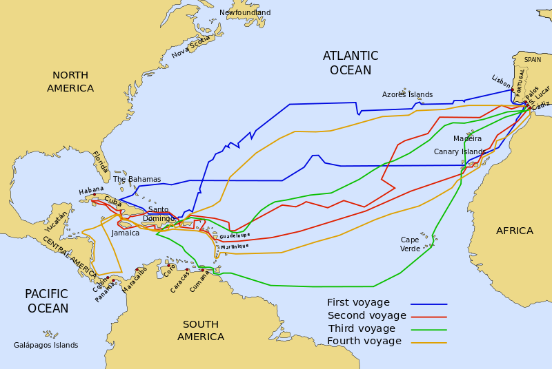
Columbus & the four journeys
Between 1492 and his death in 1506 Columbus undertook four more exploration trips to the new islands.

Slide 36
Final years
He was still convinced, up to his death, that he had discovered Asian Columbus was made governor of the new lands discovered
He could not understand why he couldn’t find the big Asian cities
Many more people followed the journey of Columbus
These people were extremely cruel to the locals, murdering and torturing them
Columbus was later charged with cruelty but proved his innocence
He died in 1506 a bitter and disappointed man

