Slide 1
Why did Cuba become such a threat to the USA?
To be able to identify the causes of the Cuban Missile Crisis

Slide 2
‘
Write a sentence to explain where Cuba is in relation to the USA.
90 miles

Slide 3
How would you have handled the beginnings of the Cuban Missile Crisis?
Event | What would you do? | Reason for your decision | Score
1.
2.
3.
4.
5.

Slide 4
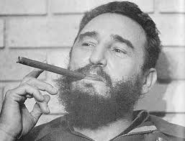
Event 1:
1959 – The island of Cuba has been taken over by Communist rebels led by Fidel Castro.
Do you:
Declare war on Cuba
Wait to see what Castro does as the new leader of Cuba.
Extra information to help you make your decision: In 1959 Cuba was not that important to the America. The previous leader of Cuba, General Batista, might have been pro-USA but he had also been a dictator who had been extremely unpopular.

Slide 5
Scores
Scores:
A: 0 points – you don’t really have any reason to invade Cuba. The rest of the world will criticis you. The USSR may well come to the aid of Cuba. A nuclear war might start.
B: 5 points – The best decision at this stage. You never know, Castro might want to stay on good terms with the USA.
What did America do?
They waited to see what Castro did as new leader of Cuba.

Slide 6
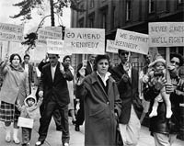
Event 2:
1960 - Castro’s new Communist government has taken over all American property located in Cuba. All American companies have been kicked out of the country. Cubans who are loyal to America or believe in capitalism are expelled from the country as well.
Do you:
Ignore the problem as Cuba is only a small problem.
Protest to the United Nations asking them to force Cuba to allow American companies back in.
Retaliate by refusing to buy any goods from Cuba.
Declare war on Cuba.
Extra information to help you make your decision: The loss of American companies on the island is not a huge problem. However, on the other hand Cuba’s economy depends heavily on America buying sugar from them.

Slide 7
Scores
2 points – This might have meant that Cuba never became a big problem. However, the US public won’t be impressed at your ‘laissez-faire’ attitude to the rise of Communism so close to America.
2 points - The United Nations would probably launch an investigation. This could take a long time to solve the issue.
5 points – The best option. Economic sanctions are seen as a peaceful way of solving a problem without starting a war. Cuba is heavily dependent on you so may well reverse their decision to get rid of American businesses.
0 points – This could well start a nuclear war if Russia come to the aid of Cuba.
What did America do?
President Eisenhower banned the import of Cuban sugar and stopped selling American goods such as oil to the Cubans.

Slide 8
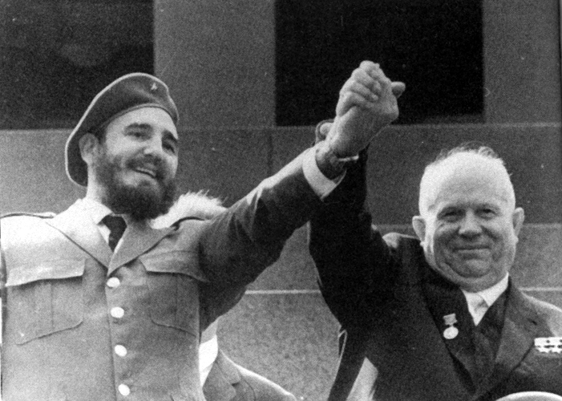
Event 3:
1960 – Cuban leader Fidel Castro asks Communist Russia to buy Cuban sugar. Russia also promises to sell oil to Cuba.
Offer to start selling American oil to Cuba and to start buying Cuban sugar again.
Complain to Russia that Cuba is in your backyard and they should stay out of its affairs.
Declare to the world that America will not tolerate Russia interference in Cuba.
Ask the CIA for a possible solution to the problem.
Extra information to help you make your decision: Cuba is only 90 miles away from the USA and was within its sphere of influence. The USA had not got involved when the Soviet’s put down the Hungarian Uprising of 1956 because they had respected that it was part of the USSR’s sphere of influence.

Slide 9
Scores
2 points – it could improve relations but it is unlikely to work now that Castro is getting everything he needs from the Russians.
2 points – This might work but Khrushchev is desperate to gain the upper hand in the Cold War so will probably ignore the complaint.
0 points – The rest of the world don’t want a nuclear war so probably wouldn’t do anything.
5 points – Probably the best option. Let the experts find a solution to the problem.
What did America do?
President Kennedy asked the CIA to find a possible solution to the problem.

Slide 10
Event 4:
1960 – The CIA offers you an invasion plan to kick Communism out of Cuba.
Do you:
Reject the idea in case it angers the Russians
Invade Cuba but only use ex-Cuban exiles living in America so if it goes wrong no Americans die.
Invade Cuba supporting the Cuban exiles with American warplanes, troops and battleships.
Extra information to help you with your decision: Both yourselves and the Russians have nuclear weapons. Angering Russia could have disastrous consequences. If any American troops are involved in an invasion then the Russians might see it as an act of war and might offer military support to Cuba.

Slide 11
Scores
5 points – probably the best option. You don’t want to start a nuclear war.
2 points – this could work. By using ex-Cuban exiles it will look like a civil war as opposed to a war between the USA and Cuba.
0 points - The use of American troops could well lead to a retaliation from the Russians and a possible nuclear war.
What did America do?
They decided to invade the Cuba using ex-Cuban exiles. The Cuban refugees were trained and equipped by the CIA. They invaded the Bay of Pigs in April 1961. The invasion was a disaster and was easily defeated by Castro and his supporters within two days.

Slide 12
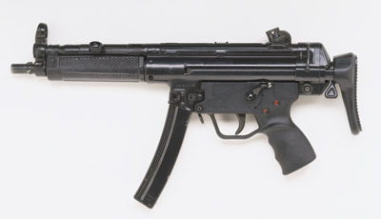
Event 5
1961 – Castro asks Khrushchev to help him defend Cuba in case of further attacks. Khrushchev agrees to start sending arms to Cuba. This could include nuclear arms as well as conventional arms.
Declare war on Cuba and send US troops to remove the Communist regime.
Order U2 spy planes to fly over Cuba regularly to check whether nuclear missiles are being placed on the island.
Send a letter to Khrushchev saying that you will remove your missiles from Turkey, as long as he promises not to put nuclear missiles on Cuba.
Extra information to help you with your decision: If the USSR put nuclear missiles on Cuba it will mean that they will be able to attack America without spending large amounts of money developing more ICBMs. If you remove missiles from Turkey it will mean that you face public humiliation and you lose your upper hand in the arms race.

Slide 13
Scores
0 points – Russia will come to the aid of Cuba and this could start a nuclear war.
5 points – This will help you collect evidence to find if there is a legitimate reason to invade Cuba.
2 points – This might be good enough to convince Khrushchev not to place missiles on Cuba, however it will be humiliating for you.
What did America do?
They started sending U2 spy planes over Cuba on a regular basis. Kennedy warned the USSR that he would prevent them by ‘whatever means necessary’ from placing nuclear missiles on Cuba. The Russians said that they had no plans to do this anyway. However, on 14th October 1962, an American spy plane flew over Cuba and took amazingly detailed photographs of missile sites in Cuba.

Slide 14
Task 2: What actually happened? Fill in your sheet of what happened.
Date | Event
1959
1960
1960
1960
1961
1961

Slide 15
Here is a fearometer Just how afraid do you think the American Public were?
Relaxed and Calm
Very Afraid
Come and stick your post it note where you think the fear level is
Make sure you justify your answer

Slide 16
Review – Why did Cuba become such a threat to the USA?

