Slide 1
Mao in power II
Domestic policies 1966-1976

Slide 2
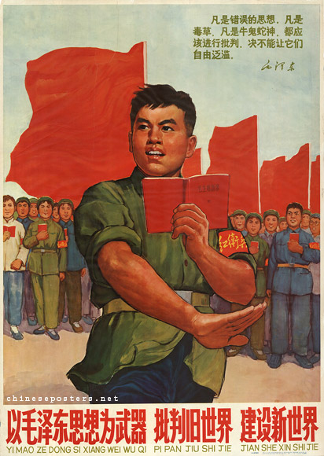
Criticize the old world and build a new world with Mao Zedong Thought as a weapon, 1966

Slide 3
Cultural Revolution –what?
May 1966 – Beijing Uni students rebelled supp by Jiang, Mao; Lin
Ed system attacked; wide ranging changes demanded; work teams
July 66 – Mao swam in Yangtze for over 1 hr – I am alive & returning
Lin promoted to vice-Chairman of Party under Mao
5 Aug 66 – Bombard the Headquarters – poster campaign
Students called upon to attack CPC
8 Aug 66 – Lins 16 Points – students to attack party members
Red Guards est – students w/red armbands & Little Red Books
Supp by PLA; To rebel is justified; attacked any bourgeoise practice
Milions joined in rampage across China – temples,libraries,schools,
CPC targetd by Jiang – Liu arrested; Zhu & Deng sent to labour camps

Slide 4
……
1966 – end of year sees Mao start to lose control
Red Guards split into factions & start fighting each other
Jan 67 – Shanghai workers overthrew city govt; embassies attacked
Feb 67 – Mao called PLA in to restore order; unrest continues
Sept 1967 – PLA ordered to use lethal force to control situation
Red Guards now under control – more disciplined PLA used
Lin & Jiang start own terror campaign vs counter-revolutionaries
1967 – 1st phase – many diff estimates – thousands > mills
1968-71 – 2nd phase – as many died again
Overall , up to 12 mill sent to c/side for re-education

Slide 5
Cultural Revolution - effects
1966-76 - Estimates vary: 100 mill population plus suffered
Zhou Enlai – survived, but died soon after
Deng Xiaoping – survived, became Premier
Agric & Ind reverses – magnified GLF failures
Hsu – virtually bankrupted China (Rise of Modern China 2000)
Education dismantled
Intelligentsia sent to c/side
Hsu – anticultural, anti-intellectual, antiscientific – affected 3 gens
1981 – CPC – the most devestating setback…initiated and led by Comrade Mao Zedong (Beijing Review; no.27; 6 July 1981)

Slide 6
….
Why did Mao launch and lead it then? No direct expl, evidence
Just before he died, Mao claimed 2 great victories….
1) Defeating Japanese & Nationalists
2) Introduction of Cultural Revolution (unfinished…)
Historical opinion differs:
Re-est own position after GLF failure,
OR
Re-est China`s socialist revolution - Perm Rev way forward
Threats from within and without – CPC; USSR; West….

Slide 7
Cultural Revolution - aftermath
1971 – CR quietening down; Mao`s CoP at maximum
Young Communist League established
Lin Biao felt under threat w/winding down of CR
Sept 71 - Organised assassination attempt & coup d`etat
Mao informed, Lin fled, plane crashed
Mao retreated to bed and stayed there in shock
Lin a traitor so CPC lost face, trust of pop
Lin now a capitalist roader BUT had been Mao`s successor?
Deng now rehabilitated after CR dismissal to Jiangxi (Zhou ill)
1974 - Jiang Qing & Mao split about this
1974-76 – Jiang and Gang of Four att to reradicalise the CR

Slide 8
Death of Mao
Jan 76 – Zhou Enlai dies; Deng oration; public commemorations
Condemned by Gang of Four; demos persecuted as counter-revs
Deng dismissed; Hua Guofeng named as Mao`s successor
Power struggle starts b/w Hua & Gang of Four
July 76 – Zhu De dies
28 July 76 – Hebei earthquake
9 Sept 76 – Mao dies; mourned but not grieved over like Zhou
Hua becomes Premier; arrests Gang of Four
http://chineseposters.net/gallery/index.php

Slide 9
Legacy of Mao
True to beliefs?
Ideologically consistent?
1945 – Japanese imperialist threat defeated
1949 – regionalism eradicated – China reborn post CW
1949 onwards – consistently mistrustful of foreign influence
1949 onwards – consistent as regards importance of P masses?
Separation of Mao from everyday reality
Imperial elites replaced by elitist SPS

Slide 10
Social Legacy
R/o/ women
Lib of Ps
Cultural devs despite CR brought C into 20th century
1949 – 50 000 scientists
1966 – 2 500 000 scientists (Meisner – China and After 1999)
1949 – 20% literacy
1976 – 70% literacy at least (although uni att v low – CR)
1965 – rural barefoot doctors introduced (CR again however)
1949 – 35 yrs LE
1978 – 68 yrs LE

Slide 11
BUT
Living conds could be atrocious
Religion denounced as superstition; persecution followed
State religion approving of maoist thought & CPC est
Artists attacked & re-educated
Inds unimportant to Mao and regime
Mass change > individual suffering

