Slide 1

TOK Fundamentals I
Personal Knowledge vs Shared Knowledge
How to….. What is….
Individual tool kit Collected wisdom

Slide 2
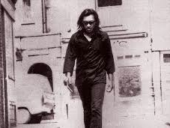
Rodriguez
US musician / construction worker
Lifestory highlights the division between personal & shared knowledge
Story takes place on two continents over a 40 year timespan, and is still evolving

Slide 3

Shared Knowledge
Accepted wisdom that everyone has possibility to access
Individual personal knowedge proven beyond a reasonable doubt
Justified true belief of human race – what we know as a species….

Slide 4

Personal Knowledge
- Individual knowledge that reflects our own interpretation of world
Base upon background, personality, education, culture etc…
A personalised toolkit that allows us to use shared knowledge….

Slide 5
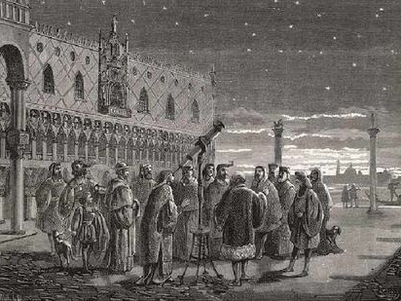
Personal-Shared Knowledge relationship
- Chicken and egg scenario in terms of TOK analysis
Which came first, which has the more important role?
How far does PK determine SK…and vice versa?!

Slide 6
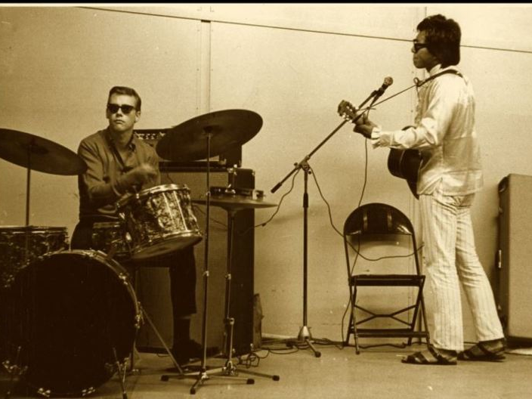
Detroit, Michigan, USA
Personal Knowledge? Shared Knowledge?

Slide 7

Evidence of _________ knowledge
How does the US story illustrate the concept of ………… knowledge?

Slide 8

Cape Town - Pretoria, South Africa
Personal Knowledge? Shared Knowledge?

Slide 9
Evidence of __________ knowledge
How does the SA story illustrate the concept of ………… knowledge?

