Slide 1
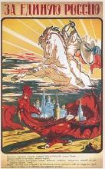
‘Revolutionary Russia : 1891-1991’ Orlando Figes
C7 – Civil war & the making of the soviet system 1918-1920

Slide 2
Brest-Litovsk
26/10/17 – BV ‘Decree on Peace’ – only prop for WRevs
23/02/18 – No WRev & Gs adv 150 mls 1 week after pact w/Ukrs
03/03/18 – Actual peace - BL - `shameful peace`
R relinquished all Euro territory
Poland, Finland, Estonia, Lithuania under G protection
Ukraine free of R troops
34% pop (55 mill); 32% farmland; 54% ind; 89% mines
BUT the BV Rev was still alive…..

Slide 3
Czech Legion & civil war
35 000 Cz/Sl POWs & AH deserters now on Soviet soil
Joined w/Rs vs AH, but stranded – only route was E via Siberia
Wanted to continue fighting v AH on WF
Mid-May – Red Guard attempted to seize weapons – fought off
08/06/18 – CL est Komuch Govt w/ RSRs – get R back in 1WW
RSRs promised to get UK & F supp – st of CW – Rs v Ws
S Russia – R Don – 1st W army moving N
Kornilov-Denikin’s 4 000 army volunteers
Rioting Cossacks 40 000 peasant militia

Slide 4
Kolchak & denikin White army offensives
Komuch Govt collapsed w/end of WWI as CL went home
SRS fled E to Omsk – ended up under Admiral Kolchak
UK, F, US supp – pol justification even w/end of WWI
1919 - 100 000 strong advanced to Volga before RA counter
Simultaneously, Denikin struck SE Ukraine & Donbas mines
Area of Cossack rebellion v RT & Decossackisation
UK, F supp – W adv w/RA in crisis – 1 mill deserters Mar-Oct
03/07/19 – Ds Moscow Directive – rapid adv to M
14/10/19 – D only 250 miles away but fatally overstretched
Routed by comb of Anarchists, Ukr Nats, RA & P militia

Slide 5
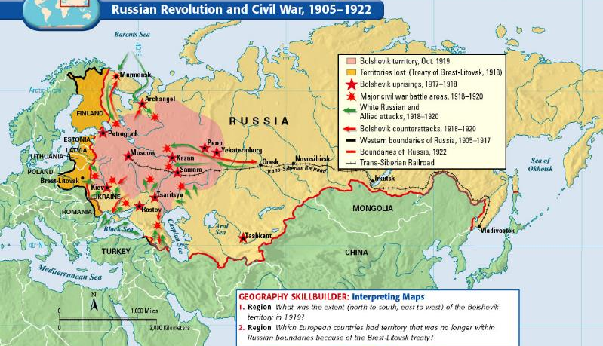
Course of the civil war

Slide 6
‘Our party is for civil war’
04/06/18 Trotsky illustrated BV stance
CW a necessary stage of class conflict
Polarise opinion b/w Rev & Counter-Rev
State extension of mil and pol power - use of Terror
All req if DotP was to emerge victorious
What was needed was a way to win….

Slide 7
Trotsky & red army
T – BV War Commissar – Red Guards being routed
RA - remodelled conscript army – still faced probs
Not popular with Party members – Military Opposition
Conscript army = P soldiers – Ps anti-Rev
Reinstatement of ex-Tsarist officers (75 000)
Centralized hierachy of command centred around T
Trotsky himself aloof; ideologically suspect; ‘outsider’

Slide 8
……..
Mass conscription likewise initially unsucc
‘18 call saw only 40 000/275 000 turn up – harvest
Numbers improved over time
Spr ’19 - 1 mill; ‘20 - 3 mill; end ‘20 - 5 mill
BUT too big w/insuff supplies & organisation
No guns, food, clothes, training - mass desertion
Vicious circle set in
Mass conscription – insuff supps – mass desertion

Slide 9
War communism - aims
Only solution – WC – 1st BV command economy
Aim – win the CW & preserve BV Rev
From Grain monopoly to complete State control
Abolished private trade
Nationalized heavy industry
Militarized labour
Introduced universal state-allocated rationing
Later revisited in St 5YPs

Slide 10
War communism – why?
Pragmatic response to CW?
Diversion from Ls preferred mixed economy ‘18 & ‘21 on?
or
WC rooted in L/ism – imposition of socialism by decree?
No!
More a means of fighting CW – but not just v Ws
Set of policies to provoke class war v Ps (hence ‘21 WC)
BUT Started as pol response to urban crisis of CW

Slide 11
‘vanguard of the non-existent class’ (Shliapnikov)
Mass exodus to c/side – 1 mill in 1st 6 months of BV rule
Petrograd’s metal inds – 250 000 to 50 000
Lessner & Erickson – 14 000 to 200
Ps reluctant to sell food for paper money – nothing to buy
Stored surplus; fattened cattle; sold on black-market
‘Bagmen’ from cities swapped clothes, gds for food
Anything and everything traded - desperation

Slide 12
War for grain
09/05/18 – BV response - Grain Monopoly announced
P grain surpluses now state property
BV requisition squads found nothing – no surpluses!
Blamed on kulaks – ‘rabid foes of the Soviet Govt’ (L)
Executions; torture; seed stocks ransacked
Hundreds of P revolts as a result
Jan 1919 – Food Levy (prodrazverstka) replaced GM
All foodstuffs incl; centralized requisition
No need to take account of Ps needs

Slide 13
‘Right of the dictatorship’
T – state needed to send people where needed acc to plan
First step – forced requisition
Ensure RA fed – desertions kept to a minimum
Ensure cities fed – ind prod maintained
Next step – labour control - ind prod now maximised
28/06/18 – Decree on Nationalization
State-app managers took over from factory comms & Tus
Final step – rationing system – complete social control

Slide 14
Dictatorship of the bureaucracy
Totalitarian state being constructed – B central to this
‘20 – 5.4 mill Govt employees (2 for every worker)
‘19-’20- 1.4 mill Party members joined – RA mainly
Taught how to act, think, behave like BVs
V low literacy; levels of ed – perfectly malleable material
Soviets – local rev assemblies to regime mouthpieces
Urban Soviets directly ruled by Party appointments
Rural Soviets run by loyal ex-RA BVs – literate sons of Ps

Slide 15
Red Terror
30/08/18 - Assass att on L – Fanny Kaplan
Prompted st of ‘L cult’ – People’s Tsar (v L wishes)
Parallel st of RT – fed BV paranoia about threats faced
Internal and external enemies (SRs; Ws; W allies….)
Only solution – constant state of CW req
Mass reprisals – CHEKA est – 1 mill victims estimated
Use of Terror always supp by L, T and Stalin
‘How can you make a rev w/o firing squads?’ (L – ‘17)
‘W/o the RT, the R bourgeoisie…..would throttle us’ (T – ‘20)

Slide 16
How did the Bolsheviks win the civil war?
RA had more men, centrally based, access to ind & comms
Ws fewer in number, divided, uncoordinated, poorly supplied
Failure of Ws to win over R people
No policies to match the BV propaganda & its messages
No symbols to fight for unlike the Red Flag or Star
No unity amongst themeselves except being anti-BV
Rightist, Leftists, SRs, monarchists, Westerners; Russians…
Never considered embracing nat causes (Pol; Ukr supp lost)
Never accepted the revolution in the c/side (P supp lost)

Slide 17
‘soviets without communists’
P supp for RA vital in victory over Ws
Fear over a return of the squires overcame anti-BV vitriol
Once Ws defeated, Ps again turned on BVs – famine
Autumn 1920 saw P armies moving v BV req squads
Makhno (Ukraine); Antonov (Tambov)
By 1921, BV control of vast maj c/side no more
Food supply to cities non-existent in these areas

Slide 18
kronstaDT
Feb 1921 – workers strikes across urban Russia
Workers Opposition – vs bourgeois specialists; bureaucrats…
Moscow then Petrograd workers called for trade, libs & C/Ass
27/02/21 ‘Workers and peasants need freedom. They do not want to live by the decrees of the Bolsheviks’
27/02/21 - Kronstadt naval base followed
‘Pride & glory of the Rev’ (T ‘17) now demanding end to BV rule
New Soviet elected; FoSp; = rations; end to repr of c/side
07/03/21 – T org bombardment of the base started

Slide 19
1921 & 10TH PARTY CONGRESS
08/03/21 – 10th PC amidst crisis
L knew it was do or die
Condemnation of Workers Opp
Secret resolution banning factions
Extension of dictatorial power all the way from top down
Central Comm – Party – country at large
Food Req replaced by tax – once paid, Ps free to sell surplus
WC central plank abandoned; NEP direct replacement
Central to new BV-P alliance (smychka)

Slide 20
VICTORY
10/03/21 – 300 Party members left for Krondstadt
Intense shelling followed 50 000 strong attack
10 000 died in the attempt
2500 sailors shot in following weeks
100s more sent to Solovki labour camp, White Sea
Workers strikes died out with arrest of leaders and NEP
P revolts longer lasting – esp in areas affected by famine
Volga, Tambov regions fought on until ground down
10 000s hostages taken; 1000s shot; villages burnt to ground

Slide 21
CIVIL WAR & THE MAKING OF THE SOVIET SYSTEM
CW – BV ‘heroic period’ – model for success
Shaped political habits for next generations
Stalin’s ‘Bolshevik approach’; ‘Bolshevik tempo’ – eg 5YPs
Military style Govt – ‘battles’, ‘fronts’, ‘campaigns’
Cult of sacrifice and greater glory
Permanent struggle against enemies
Mistrust of Ps and c/side
Planned ec – mil lab; utopian vision of state as planners

