Slide 1
Plato

Slide 2
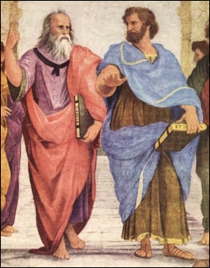
Raphael's The School of Athens

Slide 3
What do we want from life?
Don’t all men deserve happiness? And yet perhaps this is one of those ridiculous questions which I’m afraid to ask, and which ought not to be asked by a sensible man: for what human is there who does not deserve happiness? - Socrates
Plato - Euthydemus

Slide 4
How do we achieve this?
Rejection that self interest best served by seeking pleasure or power or injustice
We need to know who we are
We need to develop our virtues to live the best possible life
That best possible life is determined by the ultimate ‘Good’

Slide 5
Hedonism?
The truth, Socrates, is this: luxury and excess and freedom, if well supplied (are) virtue and happiness; those other things (morality), those agreements of men …those are rubbish, worth nothing - Callicles
Plato, Gorgias

Slide 6
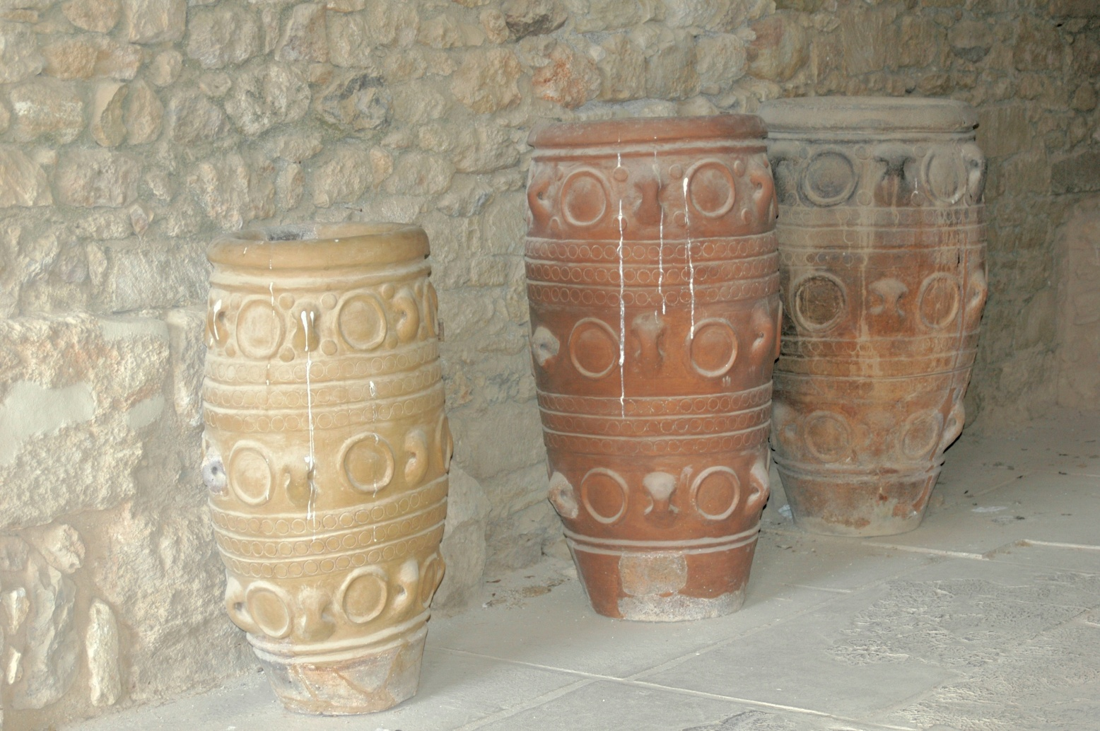
Rejection - Socrates’ Storage jars

Slide 7
Power and injustice?
When a man succeeds in robbing the whole body of citizens and reducing them to slaves…they call him happy (eudaimon) and fortunate…. So we see that injustice, given scope, has greater strength and freedom and power than justice…. injustice is in the interest and profit of oneself - Thracymachus
Plato, Republic

Slide 8
Rejection – knowledge of self
We must proceed to the further question ….whether the just live better and happier lives than the unjust…. We must look at the question more closely. For it is not a trivial one; it is our whole way of life that is at issue – Socrates
Plato, Republic

Slide 9
Tripartite division of the soul
I divide the soul into three; two horses and a charioteer (reason). One of the horses is good (spirit) and the other bad (desire)
Plato, Phaedrus

Slide 10
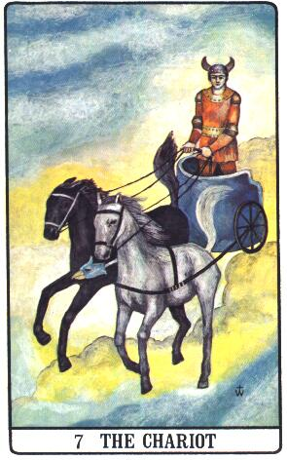

Slide 11
Virtues – wisdom; courage; self-control
When he has bound these elements into a disciplined and harmonious whole…he will be ready for action of any kind…whether it is political or personal
Plato, The Republic

Slide 12
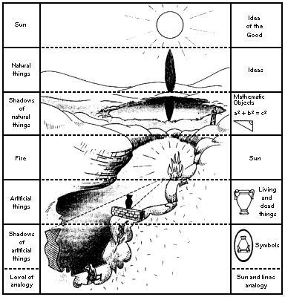
Form of the Good
No one willingly does wrong
Plato, Protagorus

