Slide 1
Word Scramble
BUAC
Cuba
STROAC
Castro
GUARS
Sugar
YBA FO GPSI
Bay of Pigs
SILEMSI
Missile
Stretch and Challenge
Once you have unscramble the words write a sentence about each one based on what you know about them.

Slide 2
The Cuban Missile Crisis: What happened?
L/O
To be able to describe the key events of the Cuban Missile Crisis
To be able to identify the effects of the crisis
To be able to explain the key features of the crisis
To reach a judgement as to who won the Cuban Missile Crisis

Slide 3
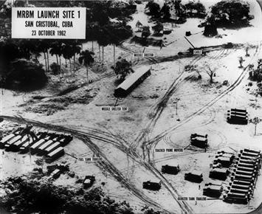
Decision 1 – What should Kennedy do about nuclear missiles?
Your U2 spy planes have captured photographic evidence that Russian nuclear missiles are being placed on Cuba. Your advisers say that the sites could be ready to launch missiles in just seven days.
Your spy planes have also reported that 20 Soviet ships are currently on their way to Cuba carrying missiles.
Do you:
A: Take the advice of your inner council (Excomm) and bomb the bases on Cuba hoping they are not yet complete.
B: Invade Cuba with US troops.
C: Talk to the USSR to see if negotiations can find a way out of this crisis.
D: Place a ring of US ships around Cuba and tell them to destroy any Soviet ships that try and pass them.

Slide 4
How did you do?
A: You have just started a war. Worse than that the rest of the world are outraged by your actions. This war would probably have become a nuclear war. (0 points)
B: Same as above. (0 points)
C: This might work. The only problem is that negotiations will last more than seven days. Khrushchev will be able to complete his missile sites in Cuba will always be able to threaten you with them. (2 points)
D: The best decision. Kennedy said that he was putting Cuba in ‘quarantine’. He had put the ball in Khrushchev’s court and would have to see whether Khrushchev was willing to risk a nuclear war by sailing through the US ships. (5 points)

Slide 5
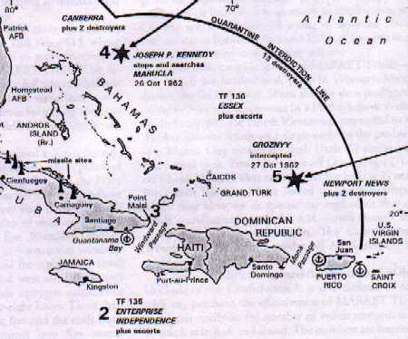
What did Kennedy do?
Kennedy’s advisors can be split into two groups. The ‘hawks’ and the ‘doves’. The ‘hawks’ believed that a nuclear war was inevitable and wanted Kennedy to go to war. The doves wanted him to do whatever he could to avoid war.
Kennedy went for a compromise. He decided to set up a naval blockade around Cuba to prevent further missiles from reaching the island.

Slide 6
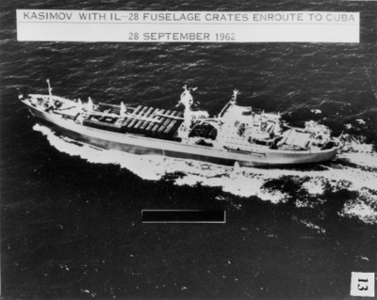
Decision 2 – How will you respond to Khrushchev’s letter?
Khrushchev sends you a letter stating that Soviet ships will break through the blockade. He also issues a statement saying that the USSR is prepared to use nuclear weapons if the USA declares war on them.
Do you:
A: Stand your ground and maintain the blockade - Send Khrushchev a letter asking him to withdraw the missiles. Repeat your original threat that if his ships try and pass your blockade you will declare war on him.
B: Declare war on the USSR.
C: Remove the blockade to make sure a nuclear war doesn’t start.

Slide 7
How did you do?
A: A risky strategy but you are calling Khrushchev’s bluff. Will he risk starting a nuclear war? (5 points)
B: You will have started a war. Khrushchev has said this will become a nuclear war. You will be responsible for the deaths and suffering of millions of people. (0 points)
C: This will prevent war but the US public will see you as weak. (2 points)

Slide 8
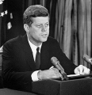
What did Kennedy do?
Kennedy stood his ground. He sent a letter telling Khrushchev that if he did not turn his ships round and remove the missiles from Cuba then the USA would declare war.

Slide 9
Decision 3: What will you do now?
Khrushchev sends you a letter saying that he will withdraw the missiles from Cuba if you promise that the USA will never invade Cuba.
The next day you receive a second letter from Khrushchev. This one says that he will remove the missiles from Cuba if you remove the American missiles from Turkey.
On the same day an American spy plane is shot down over Cuba.
Your advisers are demanding that you declare war on the USSR.
Do you:
A: Declare war on the USSR.
B: Accept the offer in the second letter and order for the removal of missiles from Turkey.
C: Ignore the second letter and agree to the demands of the first.
D: Take your brother (Robert Kennedy’s advice). He says you should publicly agree to the demands in the first letter but secretly say to the USSR that you will remove the missiles from Turkey.

Slide 10
How did you do?
A: Nuclear war! (0 points)
B: You will have prevented war but the American public will see you as weak. (2 points)
C: Risky, Khrushchev might not agree. (2 points)
D: The best option. Publicly, the American public will think you have outsmarted Khrushchev and you will also prevent a nuclear war. (5 points)

Slide 11
What did Kennedy do?
In public Kennedy said that he would not invade Cuba.
In secret, his brother Robert told Khrushchev that the missiles on Turkey would be removed.
Khrushchev ordered his ships to turn around and return to the USSR.
He ordered for the dismantling of the missile sites on Cuba.

Slide 12
Review of your learning so far – Put these events in the correct order.
Cuba becomes Communist and Castro takes control of all American property. – 1st
Publicly, Kennedy agrees to the demands of Khrushchev’s first letter. However, in secret he tells Khrushchev that he will remove the missiles.
The USA impose economic sanctions so Cuba start trading with the USSR instead.
Khrushchev agrees to remove the missiles from Cuba.
Kennedy uses Cuban exiles to try and invade the country. The invasion, known as ‘The Bay of Pigs invasion’ fails.
Khrushchev writes two letters to Kennedy. The first says he will remove the missiles if Kennedy promises not to invade Cuba the second says that missiles must be removed from Turkey as well.
Castro asks the USSR for help in case America invades again so Khrushchev puts missiles on Cuba.
U2 spy planes spot the missiles on Cuba so Kennedy sets up a naval blockade. He tells Khrushchev to remove the missiles or risk war.

Slide 13
Review of your learning so far – Put these events in the correct order.
Cuba becomes Communist and Castro takes control of all American property.
The USA impose economic sanctions, so Cuba start trading with the USSR instead.
Kennedy uses Cuban exiles to try and invade the country. The invasion, known as ‘The Bay of Pigs invasion’ fails.
Castro asks the USSR for help in case America invades again so Khrushchev puts missiles on Cuba.
U2 spy planes spot the missiles on Cuba so Kennedy sets up a naval blockade. He tells Khrushchev to remove the missiles or risk war.
Khrushchev writes two letters to Kennedy. The first says he will remove the missiles if Kennedy promises not to invade Cuba the second says that missiles must be removed from Turkey as well.
Publicly, Kennedy agrees to the demands of Khrushchev’s first letter. However, in secret he tells Khrushchev that he will remove the missiles.
Khrushchev agrees to remove the missiles from Cuba.

Slide 14
Who won the Cuban Missile Crisis?
Evidence that could be used to show the Kennedy won | Evidence that could be used to show the Khrushchev won
Stretch and challenge - Choose your strongest 3 points for each side of the argument.

Slide 15
Writing up your conclusions
On the one hand some people might think Khrushchev came out as the winner of the Cuban Missile Crisis because . . .
However, on the other hand, some people would argue Kennedy was the winner because . . .
In my opinion . . .

Slide 16
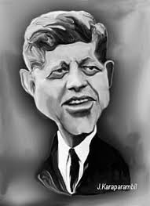
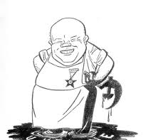
Here are the 2 contestants, Kennedy and Khrushchev
(Who is the closest to meeting their aims?)
Who won the Cuban Missile Crisis?

