Slide 1
Nazi Economic Policy
Re-Armament or Bust!

Slide 2
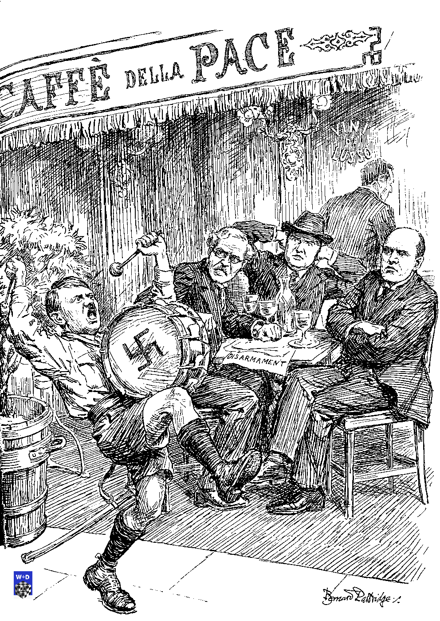
What was Hitler’s Will for the Economy?
Rearmament
Employment
Volksgemeinshaft
In control - Gleichschaltung,
Versailles ripped up,
Autarky
Lebensraum

Slide 3
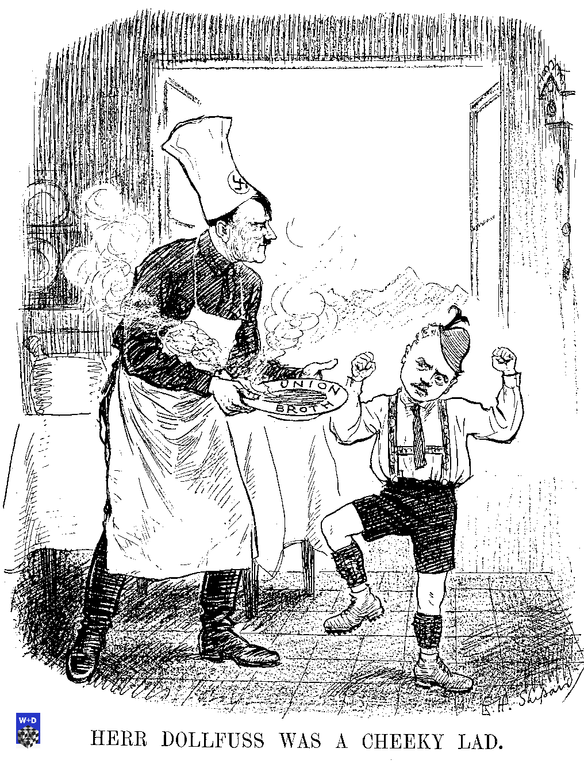
Three Key Phases
Recovery Phase (1933 – 1936) (4-12)
Schacht
Rearmament Phase (1936 – 1939) (13-35)
Goering power bid
Four Year Plan
13-36
War Phase
(1939 – 1945) (36-39)
Goering - Speer
Blitzkrieg + Total War

Slide 4
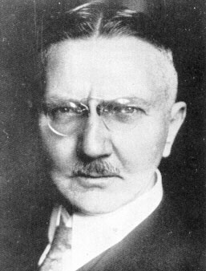
Schacht’s Miracle?
Gently at first
International Recovery underway anyway
1929 - 1933 the deepest part of the Depression
Priorities
Wished to reassure Industrialist backers
Not Socialist redistributors despite their name
Reassure International money markets/investors
Unemployment
Rebuild Germany
Catch up with neighbours
Hitler still busy consolidating his power base

Slide 5
Unemployment

Slide 6
Schacht’s Miracle?
Missing from statistics
Jews
Youth Service
Conscriptees (1935 - )
Married women
Agricultural workers
Was Hitler a friend to the workers? Or to the Capitalists?
How did Hitler think that he achieved his so-called economic miracle?
Did his totalitarian political ideas aid his economic goals?
Stimulation of Economy
Public Works
Houses
Roads
Grants to Newlyweds
Tax relief for supportive industries
Deficit Financing
Mefo bills
To avoid inflation
Government Controls
Removal of Trade Unions
Wages and Prices set

Slide 7
“What we have achieved in two and a half years in the way of a planned provision of labour, a planned regulation of the market, a planned control of prices and wages, was considered a few years ago to be absolutely impossible. We only succeeded because behind these apparently dead economic measures we had the living energies of the whole nation. We had, however, first to create a number of technical and psychological conditions before we could carry out this purpose.
In order to guarantee the functioning of the national economy it was necessary first to put a stop to the everlasting fluctuations of wages and prices. It was further necessary to remove the conditions giving rise to interference which did not spring from higher national economic necessities ie to destroy the class organisations of both camps which lived on the politics of wages and prices.
The destruction of the Trade Unions, both of employers and employees, which were based on the class struggle demanded a similar removal of the political parties which were maintained by these groups of interest, which interest in return supported them. Here arose the necessity for a new conservative and vital constitution and a new organisation of the Reich and state.”
Adolf Hitler 1935

Slide 8
Impact of Schacht’s Policies
Industrial Production doubled
Full employment (of a sort)
Industrialists satisfied that they could work with the Nazis
International sceptics silenced
Investment in Infrastructure
Electrification, new media, auto industry
Trade Unionists suppressed
Removal of wage demand pressure
Balance of Trade Crisis
Recovery sucked in imports
Run on foreign currency and gold reserves
1934 ‘New Plan’
Regulation of Imports
All had to be approved
Bilateral Trade Agreements
Barter preferred

Slide 9
Government Finances

Slide 10
Guns or Butter?
Schacht’s currency stabilisation policies were very complicated
Multiple exchange rates depending on markets and products sold
1935 Fat and Meat shortage
Schacht blamed Darre’s ministry of Agriculture for poor planning
He argued that Darre’s ministry should never have been separated from Ministry of Economics
Goring brought in as arbitrator
“Would you rather have butter or guns?
Shall we bring in lard or iron ore?
I tell you, guns makes us powerful. Butter only makes us fat.”
Goring’s public comments on 1935 butter and fat shortages
However, Hitler very sensitive to comments about dissatisfaction and secretly tells Schacht to release funds to allow butter and fats to be imported.
Plus Massive propaganda blitz

Slide 11
Schacht Out, Goering In
Goering used Schacht / Darre spat as an opportunity to carve out a new role for himself.
Envious of Himmler’s growing powers
Schacht increasingly sidelined
Repeatedly calls for government control of spending
Falls out with Ministers not keeping to their budgets
Scoffs at Keppler’s Autarky ideas
1936 Foreign Currency and Raw Materials Commission
Schacht and Blomberg request that Goring head new commission
Assumed ignorant of economics
Trusted friendly face of Nazi regime
Hoped he would maintain or slow down rearmament
But, Goring was an intriguer who saw an opportunity for himself
Rather than investigate the problems he would take ‘necessary control’
Goring gets to control manufacturing and materials for his Luftwaffe
Gets to separate armed forces from a United command

Slide 12
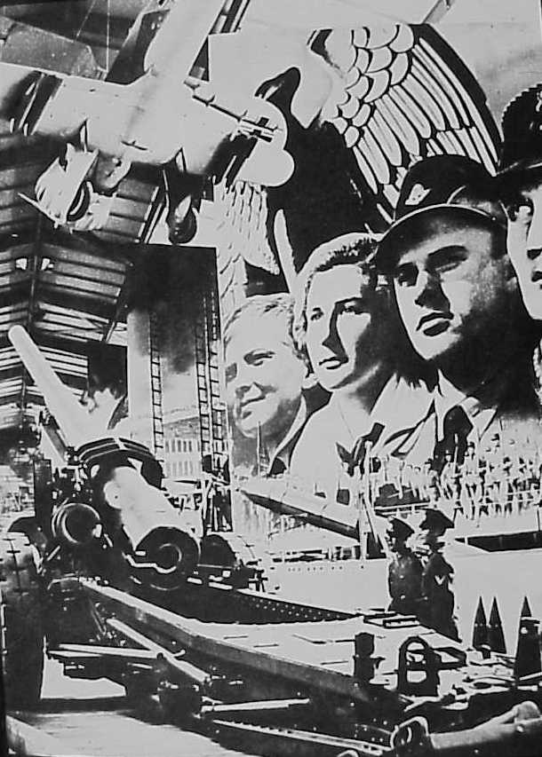
The Four Year Plan 1936 - 1940
Why 1936?
Impressed by Stalin’s Five Year Plan claims
Confidence restored to German economy
Employment
Hitler’s hubris
Hitler impatient with Schacht’s cautiousness
Goering keen to set up new re-armament programme
Prussian empire eroded
Rearmament not keeping up with political and diplomatic advances
Period of Revolutionary Imperialism
Spanish Civil War
War initially planned for 1942-43
Speeded up Nazification of the Armed Forces

Slide 13
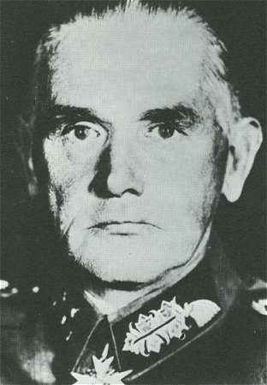
The Army Trumped
Blomberg’s Conditions to Hitler for the Army to accept the
authority of Goring’s Four Year Plan
Schacht to be responsible for economy in Peace Time
Goring’s office to be abolished if war broke out
The Ministry of Defence was to supervise the Four Year Plan
Hitler’s Response:
Ignore him completely
The German Army’s veto was ignored for the first time in German history

Slide 14
Ordination of Four Year Plan
The realization of the new Four Year Plan-announced by me at the Party Congress of Honour- requires homogeneous leadership of all forces in the German nation and the strict coordination of all competent authorities in Party and State.
The execution of the Four Year Plan, I entrust to Minister-President General Goering.
Minister-President General Goering shall take all steps necessary for the execution of the task put before him; he is authorized to issue decrees of ordinances and general administrative directives.
He is empowered to receive reports from all governmental agencies, including the highest agencies of the Reich and from all Party offices, their departments and attached organizations-and issue orders to them.
Berchtesgaden, 18 Oct 36 The Fuehrer and Chancellor of the Reich - Adolf Hitler

Slide 15
Aims of the 4YP
I herewith set the following tasks:
I. The German armed forces must be ready for combat within four years. II. The German economy must be fit for war within four years.
The extent of the military development of our resources cannot be too large, not its pace too swift

Slide 16
Autarky in 4YP
I. Parallel with the military and political rearmament and mobilization of our nation must occur as an economic one, and this is at the same speed, with the same determination and if necessary with the same ruthlessness. In future the interests of individual gentlemen cannot play any part. There is only one interest, and that is the interest of the nation, and only one conception, which is that Germany must be brought politically and economically to the point of self-sufficiency.
II. For this purpose, foreign currency must be saved in all those fields where needs can be satisfied by German production, in order that it may be used for those necessities which under no circumstances can be fulfilled except by imports.
III. Accordingly, German fuel production must now be stepped up with the utmost speed and brought to definitive completion within 18 months. This task must be attacked and executed with the same determination as the waging of war, since on its solution depends the future conduct of the war and not on the stocking of gasoline supplies.

Slide 17
Autarky in 4YP (cont.)
IV. The mass production of synthetic rubber must also be organized and secured with the same speed. The affirmation that the procedures are not as yet fully determined and similar excuses must not be hard from now on. The question under discussion is not whether we wait any linger; if we do time will be lost and the hour of danger will take us all unaware.
V. The question of production costs of these raw materials is also of no importance, since it is still more profitable for us to produce expensive tires in Germany and utilize them, than to sell theoretically cheap tires (that are made from imported rubber) -- but for which the Minister of Economics cannot grant foreign currency and which therefore cannot be manufactured because of the shortage of raw materials and consequently cannot be sold.

Slide 18
Anti-semitic underpinnings of the Four Year Plan
In addition, I deem it necessary to conduct at once a re-examination of the outstanding foreign exchange credits owned by German industry abroad. There is no doubt that the foreign capital of our industries today is quite enormous. And there is also no doubt that this is to hide the abominable intention of many men to provide for all eventualities by keeping certain reserves abroad in order to remove them from internal confiscation! I see in this a deliberate sabotage of the national economy and the defense of the Reich, respectively, and I therefore deem necessary the passing of two new laws by the Reichstag:
a. A law providing capital punishment for industrial sabotage
b. A law making Jewry in its entirety answerable for damage done to German industry and thereby to the German people by individual members of this criminal group.

Slide 19
“I am now sitting in your chair!”
4YP 1936 :
Autarky
Re-armament
Foreign Currency
4YP 1937 :
Trade
Manufacturing
Transport
Investment
Schacht’s Economic Ministry losing to 4YP
Army asked 4YP for budget increase
66% of Budget controlled by Goring by 1937
Schacht seriously undermined

Slide 20
The Rise and Rise of the 4YP
Schacht discredited when his own predictions of inflation and economic meltdown do not occur
“Measures which in a state with a parliamentary government would probably bring about inflation do not have the same results in a Totalitarian state.” Goering

Slide 21
Success breeds Success
Administrators, Businessmen and Nazi officials attracted to the new powerful office of the 4YP
Eg Herbert Backe – Director of Farm Production
IG Farben keen to head autarky programme

Slide 22
When is a private company private?
Nominally, firms were private companies
However, the 4YP directed:
Which companies got contracts
Money to be invested
Where plants were sited
Quantity and Type of Raw materials to be used
Prices to charge
Wages to pay
Profit to be made
How profit was to be spent
Eg reinvestment
Compulsory purchase of government bonds

Slide 23
Who should run the German economy?
Conservatism versus National Socialism
Conservatives had supported Nazis as it was assumed that they would protect conservative values from the radical socialist\communist ideas
Conservative Economic Ideal
Private companies should be the engine of economic growth
Schacht
“the State should not run business itself, and take the responsibility away from private enterprise”
Nazi Economic Ideal
Whatever it takes to make Germany great!
Favoured Industrialists if possible
Heavily directed
State control if necessary
National Socialism (Socialism for the benefit of the Nation)
The State if necessary (Public sector)
Goring
“The State must take over when private industry has proved itself no longer able to carry on”
Economic carrots could be used as political sticks
i.e. do it our way or not at all!

Slide 24
Nazi Meddling
Plenipotentiaries:
Sent to private firms to :
Ensure policies were carried out
See targets were being met
Make sure standardisation of purchasing achieved
Advise and Direct
First & foremost members of the Nazi party
Political loyalty more important than economic competence
Meddling often resented by professional managers, businessmen etc…

Slide 25
Industrialists Balance Sheet
Benefits to ‘Favoured’ Industrialists of Nazi Rule
Disadvantages to ‘Favoured’ Industrialists of Nazi Rule
Improved Profits
Economic Recovery
Control of Wages
Weak Labour Force
Government Contracts
State control of Imports
Autarkic Policies
Threat of Nationalisation
Control of Prices
Slave Labour
High taxes
Limits on Profits
Cronyism & Nepotism
Lack of Incentive to innovate

Slide 26
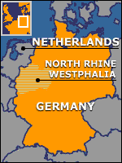
Standing up to Nazi Economic Policy
Ruhr Region
Previously a stronghold of left wing political activism
Communism
Social Democracy
Trade Unionism
Even the left wing Nazi Strasser
Rhenish-Westphalian coal Syndicate
Unhappy with Nazi meddling in company affairs
Industrialists created a Cartel to attempt to maintain some independence from Nazis
Serious challenge to Nazi rearmament plans
Coal and Iron critical to rearmament plans
Even if the coal and iron was low grade

Slide 27
The Nazi Divide and Rule Response
The advantages of Totalitarianism
Goring threatened all industrialists with imprisonment as saboteurs
Coal and iron regarded as strategic goods
Threatened with Treason!
Krupp lured away from Cartel
offered a primary position to break them away from the cartel
Becomes a ‘favoured’ Industrial Conglomerate
Other companies lost all government contracts
Directors, shareholders and managers arrested
The Conservative Schacht realises he has lost the ideological battle with Hitler
He resigns (1937)
No brakes on Nazi Economic policy from here on!

Slide 28
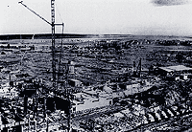
The Hermann Goring Reichswerke
Huge Industrial Complex
State Ownership of key re-armament industrial complex
Too important to leave to a Private company
Largest in Europe
Parallels with Magnitogorsk
Economies of Scale
Centralised on location of raw materials
Totalitarian methods of building and running
Forced evictions
Slave labour
Virtual unlimited control on resource allocation
Autarky methods
However, it would prove to be an inefficient producer
Coal and steel production never rises above 1939 level despite massive investment
Nazi ‘Yes men’ rather than businessmen
Poor working conditions, low morale, conscripted workforce

Slide 29
Was the 4YP a success?
Use your own knowledge and your text books to provide evidence of whether the 4YP was a success or not!

Slide 30
Was the 4YP a success?
Full employment?
Inflation kept under control!
Germany rearmed!
Army
Tanks
Navy
Pocket Battleships
Luftwaffe
Tactical bombers
Fighter aircraft

Slide 31
Was the 4YP a success?
Autarky uneconomic!
Self-sufficiency is an uneconomic allocation of resources
Lebensraum and Expansion became a necessity
Patchy production increases
Bureaucratic meddling
Distorted market forces
Slave economy
Poor working conditions
Few incentives
Inflation controlled through price and wage controls
Bureaucratic chaos
No standardisation
Jealousy
Served favourites first
Bureaucratic competition for scarce resources
Luftwaffe before army before navy
SS before Wehrmacht
Germany was not prepared for war!
It was ready for short, sharp Blitzkrieg wars but not a long attritional war!

Slide 32
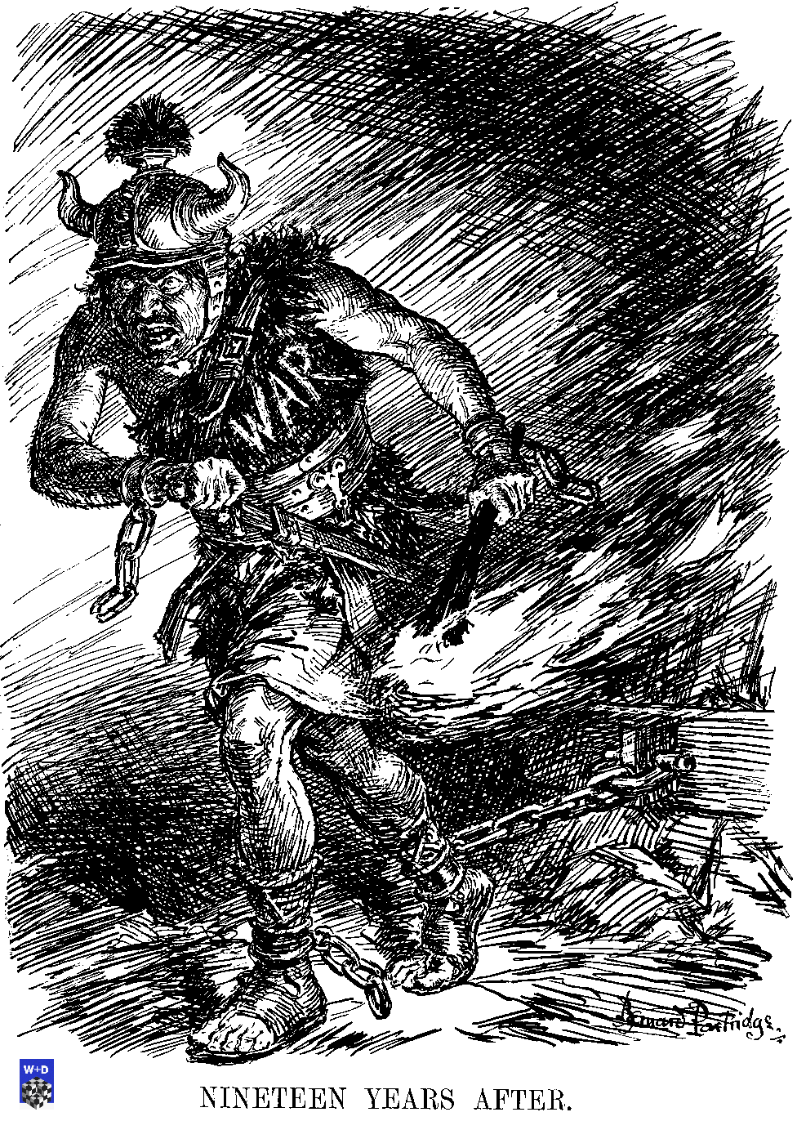
Did Nazi Economic Policy lead to war?
Was the entire German economic system heading for meltdown in 1939?
Did the Nazi government have the confidence to ask for more sacrifices from the German workers?

Slide 33
Government Finances

Slide 34
Economic Strain 1939
Overheating economy
Rearmament and Public Works
Shortages
Raw Materials, Food, Consumer Goods, Foreign Exchange, Gold, Labour
The armed forces competed for resources with industry
Manpower, raw materials, infrastructure
Wage Pressure
Shortage of Labour
Reluctance to recruit women
Agricultural Problems
Workers leaving countryside
Price freezes

Slide 35
Economic Strain 1939
Balance of Payments problem
Imports growing
Exports declining
Budget not balancing
International investors scared off
Jewish finances already confiscated
Reserves drying up
Producing few goods of export value
Reluctance to ask workforce to make further sacrifices for the re-armament programme
Eg no rationing even contemplated
Women not required to work
Wage cuts avoided

Slide 36
The Early War Economy 1939 - 1941
Anschluss of Austria and Czechoslovakia
Gained access to new raw materials
Skoda tank works
Hitler had originally planned for war in 1942/3
Even 4YP was expected to run to 1940
Not ready for war in 1939!
Rushed into war earlier than expected
Hitler genuinely surprised by Franco-British decision to fight over Poland
Competing agencies vied to supply armed forces
Confusion, waste, duplication of effort, lack of coordination, incompatible equipment, competition for best equipment
Prestige projects rather than sensible projects

Slide 37
Blitzkrieg Warfare
Military planned for Blitzkrieg Tactics
Short, sharp campaigns
Requiring speed, mobility and organisation
Poland, France perfect examples
Able to exploit conquered nations economies
Extended campaigns highlighted weaknesses in equipment and supply
Inability to knock Britain out of war
Europe, N Africa, Aegean campaigns
Inferior tanks, multiple variants, gasoline engines
Inadequate Anti-Tank guns - 88mm
Luftwaffe
Wrong kind of planes for strategic bombing
used up valuable aeroplanes and still failed to achieve its strategic aims
RAF strategically bombing Germany at will
Navy
Invested in Battleships rather than submarines
Russia
Highlighted inappropriate equipment for terrain and weather
Narrow tracked tanks
No heating systems
No winter uniforms (except Luftwaffe)
Wrong train gauges
Vast distances for trucks to travel
(burning more petrol than they were able to bring to the tanks!)

Slide 38
War of Attrition, 1942 - 45
Goering blamed for 4YP and Luftwaffe failures
Fritz Todt
Inspects Russian Front 1942
He warns Hitler that they cannot continue to fight for long with existing supply system
Organisation Todt given the responsibility to centrally plan to fight for a long term war
Total War philosophy finally introduced
More use of slave labour (plenty of new slaves)
Actually give Industry more freedom from government controls
Set priorities/targets allow industry to figure out how to achieve them
Central Planning Board
6,000 experts drawn from industry itself
Simplify and harmonise manufacturing process
Standardisation and simplification of equipment
Eg Tank destroyers
Todt killed in air crash 1942
Speer takes over OT
Officially takes control over 4YP in 1943 too
Manages to double production despite massive allied bombing

Slide 39
Favoured Industrialists: Dependence upon IG Farben
Product | Total German Production | Percent Produced by I.G. Farben
Synthetic Rubber | 118,600 tons | 100
Methanol | 251,000 tons | 100
Lubricating Oil | 60,000 tons | 100
Dyestuffs | 31,670 tons | 98
Poison Gas | ? | 95
Nickel | 2,000 tons | 95
Plastics | 57,000 tons | 90
Magnesium | 27,400 tons | 88
Explosives | 221,000 tons | 84
Gunpowder | 210,000 tons | 70
High Octane (Aviation) Gasoline | 650,000 tons | 46
Sulfuric Acid | 707,000 tons | 35

